Slide 1
Emergence of Bangladesh North South University Dhaka, Bangladesh SaMS, HIS 103

Slide 2
Bengali Hindu Renaissance

Slide 3
Bengal Renaissance refers largely to the social, cultural, psychological, and intellectual changes in Bengal during the nineteenth century, as a result of contact between certain sympathetic British officials and missionaries on the one hand, and the Hindu intelligentsia on the other.
The setting for the Bengal Renaissance was the colonial metropolis of Calcutta.

Slide 4
There were four aspects of the Renaissance movement, which the Bangali intelligentsia developed systematically throughout the nineteenth century.
First, there was the modernization of the Bengali language and the simultaneous birth of a new Bangali literature.
Secondly, there was the rediscovery of, and identification with an Indian classical era hailed as a golden age which placed South Asian civilisation on a par with the grandeur of Greece and Rome.
Thirdly, there was the Sreerampore missionary interpretation of the Protestation Reformation, which Indians applied creatively to their own historic situation.
And finally, there was the secular view of universal progress on which India's hope lay not in resurrecting the past but in projecting the golden age into the future.

Slide 5
When the College of Fort William hired the Baptist missionary, william carey in 1801, as head of the Bengali Department every available kind of financial, technological, and human resource was put at his disposal.

Slide 6
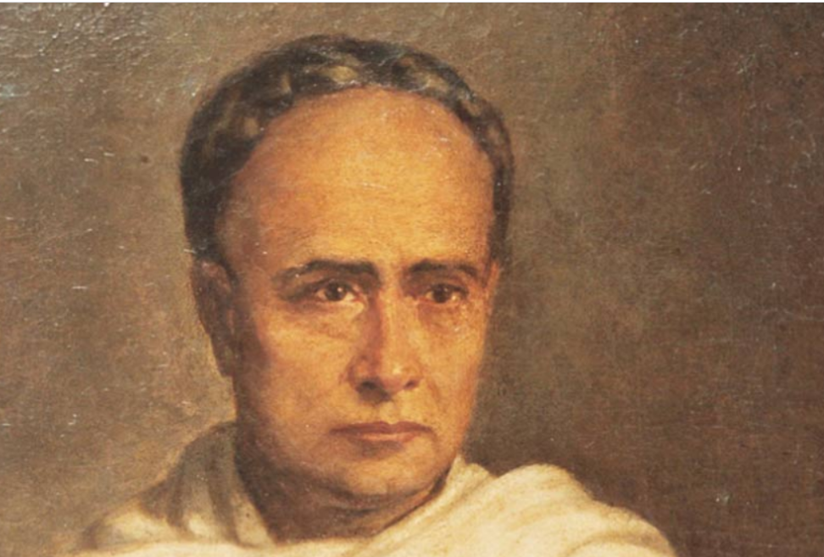
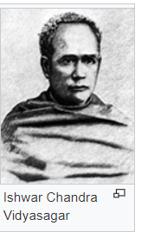

Slide 7
Vidyasagar, Ishwar Chandra (1820-1891) Sanskrit scholar, writer, educationist, humanist pundit, social reformer and philanthropist, was born on 26 September 1820 in a poor brahman family in a village in Medinipur. His father Thakur Das Bandhyay was a clerk at a shop in Kolkata
Vidyasagar did not write in one single style; for example, the style he followed in his textbooks was, of course, different from the one he used in his literary works.
Passing of the Hindu Widow’s Remarriage Act

Slide 8
The Hindu Widow's Re-marriage Act, 1856 (For details, see the link: http://bdlaws.minlaw.gov.bd/act-9.html)
Marriage of Hindu widows legalized

Slide 9
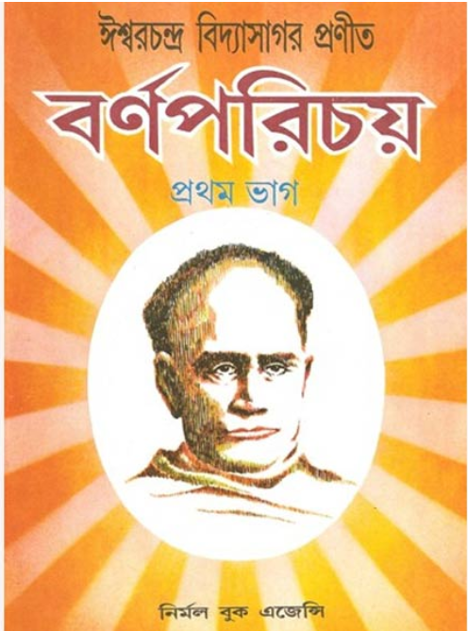
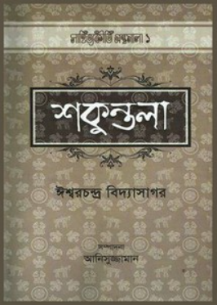

Slide 10

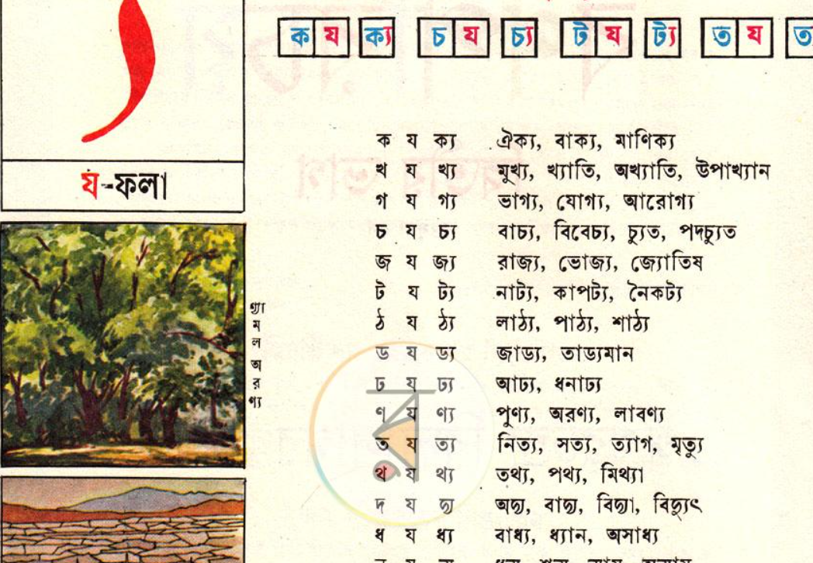

Slide 11
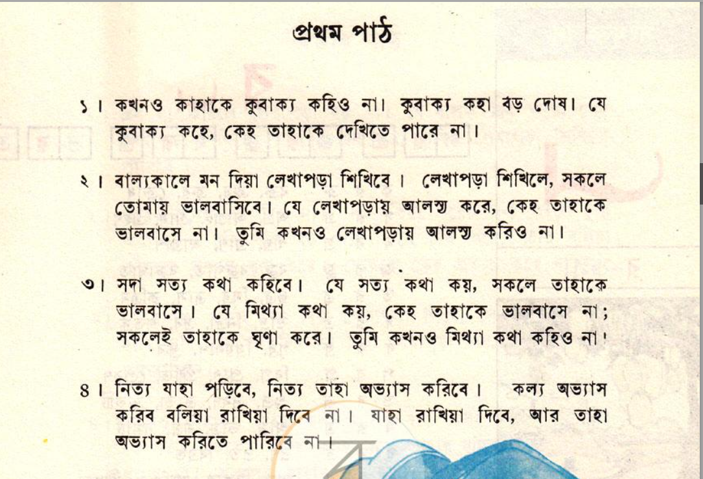
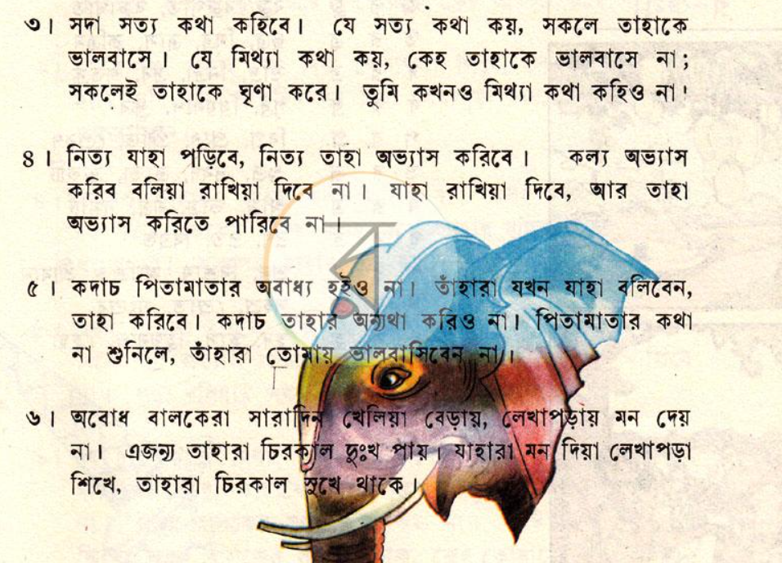

Slide 12
Ishwar Chandra Vidyasagar will be more remembered as one of the greatest intellectuals and activists of the 19-century and the ‘Father of modern Bengali prose.’

Slide 13
If Rammohun Roy played the role of the first humanist pundit in Bengal by translating, reinterpreting and publishing old shastras, and thus started the process of the Bengal Renaissance, Vidyasagar was the second. Whereas the former did it mainly for his campaign against sati, the latter did it for the remarriage of child widows, stopping polygamy, introducing female education and for improving the condition of the down-trodden in society, particularly women.

Slide 14
Writers such as michael madhusudan dutt (1824-73) and rabindranath tagore (1861-1941) wrote beautifully in English but that they also chose to express their literary genius creatively in Bangali certainly helped shape the renaissance of that literature. Dutt's Meghnadhbadh Kabya and Tagore's geetanjali for examples, were renaissance masterpieces in the manner that tradition was modernized. It is of no small importance that Tagore was awarded the Nobel Prize for Literature in 1913, one year after he published an English translation of Geetanjali (Song Offerings).

Slide 15
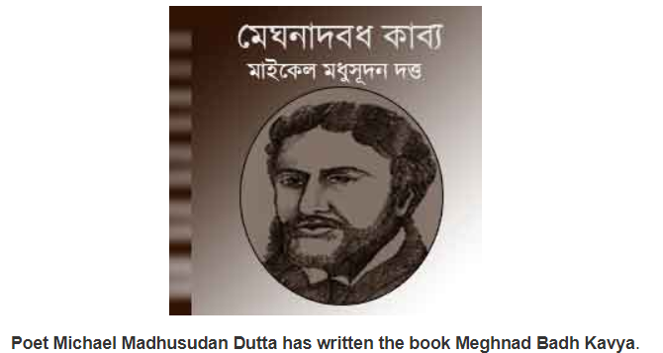

Slide 16
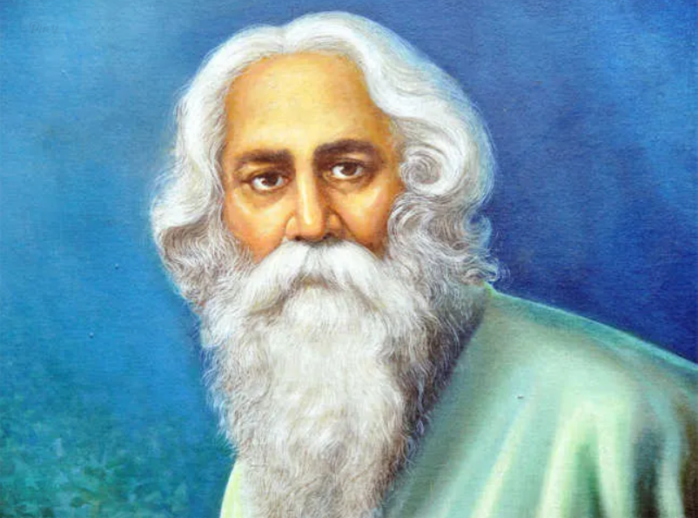

Slide 17
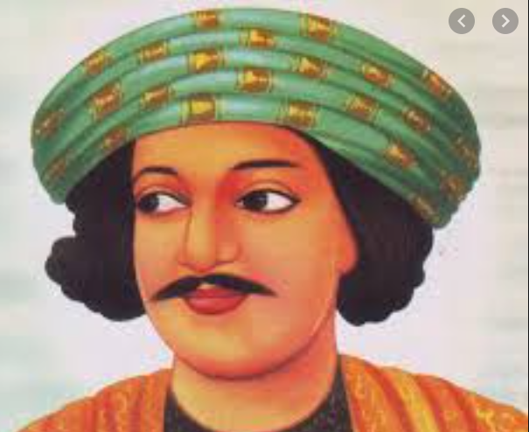
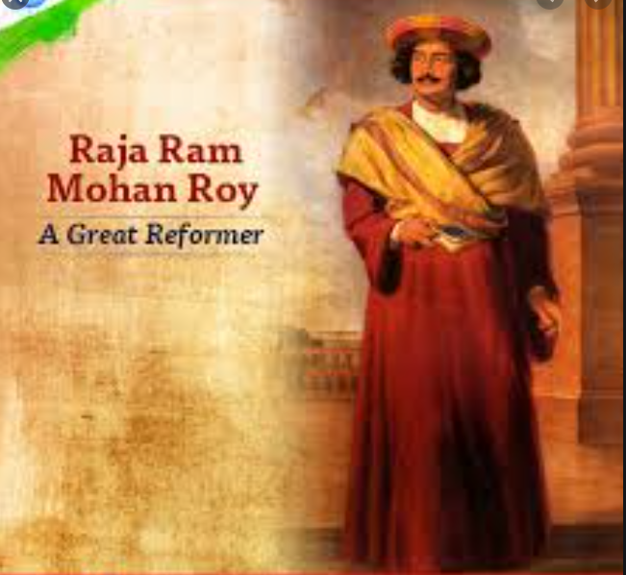
If the Bengal Renaissance produced one outstanding progenitor who imbibed the Orientalist contribution as effectively as he did linguistic and literary modernization and the effective defense of Hindu theism against the double-edged challenge of Christianity and secularism, it would be rammohun roy

Slide 18
Roy, Raja Rammohun (1772/74-1833) the great reformer, was born in a conservative Brahmin family in the village Radhanagar, West Bengal. He received the traditional education that was common in 18th century India. During his boyhood and early youth he had acquired remarkable proficiency in several oriental languages such as Sanskrit, Arabic, Persian, besides Hindi and his mother tongue Bangla.
He became well versed in Hindu religious scriptures and through his close contact with Muslim scholars and officials of the revenue and judicial departments of the east india company’s government gained considerable knowledge of Islamic theology and jurisprudence. It may be noted that until 1837 the East India Company’s Government as the language of official business in revenue and judicial transactions retained Persian. After Rammohun settled in Calcutta and published his translation of the Vedanta in 1815.

Slide 19
Raja Ram Mohan Roy was the founder of the Brahma Samaj, which played a major role in reforming and modernising the Indian society. In August 1828 Rammohun founded the 'brahma sabha' or Society of God, which in fact emerged as a new sect of Hinduism. He inaugurated the great age of Hindu reform. The public opinion, which he was able to arouse against the evil practice of satee, ( the custom of burning of widows upon the funeral pyres of their deceased husbands) influenced the government to abolish it in 1829 through a special legislation. He denounced the Hindu caste system.
গৌড়ীয় ব্যাকরণ বাঙালি রচিত প্রথম বাংলা ব্যাকরণ। রচয়িতা রাজা রামমোহন রায়, প্রকাশিত ১৮৩৩ খ্রিস্টাব্দে

Slide 20
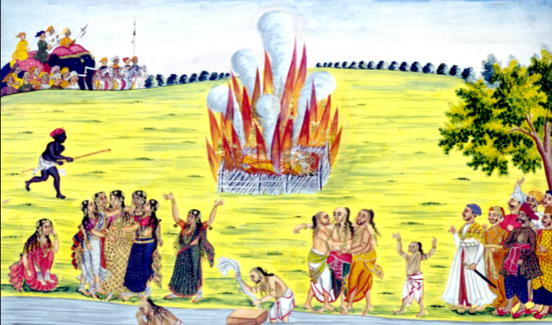

Slide 21
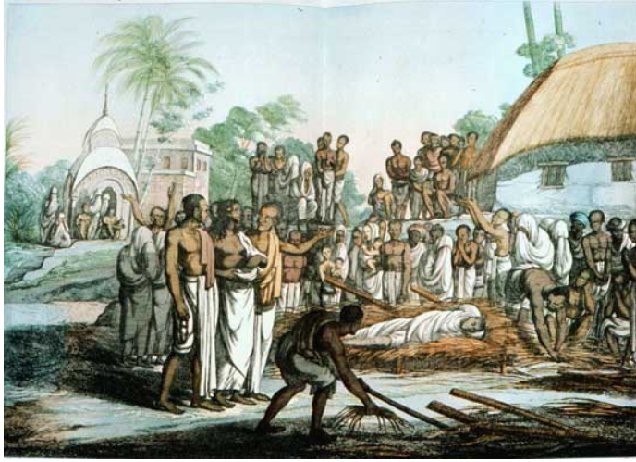

Slide 22
Raja Ram Mohan Roy also contributed much to the growth of national consciousness in the subcontinent. In his political views he was greatly influenced by the philosophy of Jeremy Bentham. Principle of “utilitarianism”: Welfare of the people –Greatest happiness of the greatest number of the people.
Rammohun and other Bengali leaders who followed him were loyal supporters of the British raj. They believed that in course of time the political privileges that the British people at home were enjoying would be extended to the people of the British territories overseas.

Slide 23
In 1830 Rammohun Roy left for England to represent to the British king and parliament the grievances of the titular Mughal Emperor Akbar II (1806-1837), who had invested him with the title of 'Raja'. In England he was widely acclaimed by leaders of British society. He also visited France in 1832.
In 1833 while visiting Bristol he fell ill and died on 27 September. Debendranath Tagore, Rajmohan Majumdar, Prasanna Kumar Tagore etc. were the followers of Rammohun Roy.

